Slide 1
Starting Back
to School
Resource Pack

Slide 2
Top tips for preparing your child for school This section has a list of things to try and help your child prepare for school, including how to get your child prepared to wear a school uniform again.
School separation anxiety tips
These are some tips to help your child with managing school separation anxiety when school starts again.
Communication passport
This communication passport can help your child’s new teacher understand their individual needs, likes/dislikes and sensory differences to ensure they are supported and understood at school.
Starting School Social Story The social story talks about the importance of going back to school and what it might look like. In the spaces provided you can add in a picture of your child’s school and their teacher. It also has a section to help them remember what they enjoyed about going to school and to list them.
Weekly Planner You can use the weekly planner provided to help your child recognise when school is starting but also to help them see what days they will be in school and what days they will be working from home.
How are you feeling board This is an activity to help your child express how they are feeling about going back to school and what they could do to calm down. This could be use alongside the Anxiety Resource Pack found on our website www.autismni.org
Grounding Techniques
These grounding techniques can encourage children to calm down and manage big emotions such as anxiety and fear by offering distraction,. Grounding exercises also encourage children to focus on what is around them rather than thoughts or feelings that upset them.

Slide 3
Back to School Top Tips
Once you know school is starting again, it is time to start to talk about it with your child.
Use a calendar to start the countdown for going back to school.
Get your child to tick off each day as it passes.
Start to get your child back into the school routine i.e., going to bed earlier, show uniform that needs to be worn, have a good morning routine.
Start to drive past the school to help your child get into the way of the school run again.
On the week of school begins, use a weekly planner to show what day school is starting on, alongside the calendar.
Have a picture of something your child likes to do under the school picture, that could be completed together once their school day has ended. For example, going to the park, baking or a board a game.

Slide 4
Use Social Stories to explain why it is important to go to school.
If possible, go onto school website to show who their teacher is going to be.
Check with school if you can visit it before hand to show your child their classroom and where they will be sitting.
Remind them of all the fun things they do in school, i.e., see friends, play outside, draw/paint etc.
Share with the teacher (through phone call or meeting) what your child has been up too and how they got on with the schoolwork at home.
With your child talk about what they have done while not being in school and that their teacher is excited to hear about it.

Slide 5
Uniform Top Tips
Discuss with your child what they need to wear to school.
Ask your child if they can find their uniform.
Start to have the uniform visible again to your child, i.e., hang it in their bedroom, leave it on a chair for them to see.
Show pictures to your child of them in their uniform, remind them that they have worn it before.
Try the uniform on gradually, i.e., socks on one day, then skirt/trousers and socks the next day etc.
Practise putting the uniform on but also taking it off especially their school jumper, in case they get too warm in the classroom and do not like asking for help.
Put their name on the uniform to help them know that it belongs to them or alternatively use a favourite sticker to place on uniform, i.e., dinosaur stickers. This could also be used as a motivator to wear the uniform.
Discuss with your child’s school any reasonable adjustments around school uniform to accommodate sensory needs.

Slide 6
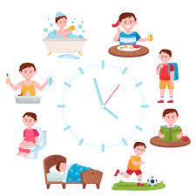
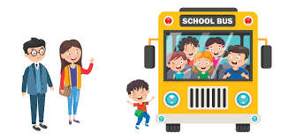
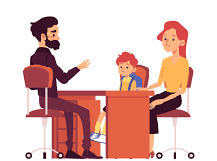
Tips for managing school separation anxiety
Use a transitional object.
Stick to a routine.
Have a goodbye ritual.
Teach your child calming strategies.
Decide on a goal, then break it down into small steps and work up to bigger challenges.
Model a positive goodbye.
Acknowledge your child’s feelings and validate them.
Talk to your child’s teacher about their anxiety.

Slide 7
Starting Back to School

Slide 8
My name is
Communication Passport
Communication
I prefer to communicate by
When communicating with me please do this:_______________________________________________________________________________________________________________________
Words
Gestures (eyes/hands)
Please don’t:______________________________________________________________________________________________________________________
One thing I like
Writing things down
Other
Sensory- I am affected in these ways
One thing I don’t like

Slide 9
Things I might find hard
Things that might make me stressed or upset?
Waiting ___
Taking Turns___
Working in groups___
Following instructions___
Remembering to write work down___
Working on my own initiative___
Concentrating___
________________________________
________________________________
________________________________
You can tell I am upset because I will
How you can help me
These might make me feel better
Brain Breaks___
Ask If I need help___
Prompt me to do next task___
____________________________
____________________________
____________________________

Slide 10
All boys and girls are going back to school. Summer is over
It is important that children go to school.
I have been off school for 2 months.
It is exciting to go back to school.
Add in picture of school
My school is called _______________________________________
I will go back to school on__________________________________
Like every year I will get a new teacher. My teacher is called_______________________________________________
Add in picture of teacher

Slide 11
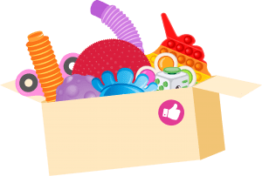
I can use my weekly calendar to see when I will start school.
I might feel scared or anxious about starting school again, that is ok. I can speak to a parent or grown up I trust about how I am feeling. I can also use my feelings chart.
I can also use my calm box if I need to calm down. I can ask my teacher if I can bring my calm box to school. Then I can use it when I need too.
Going back to school is exciting. I will get to
See my teacher again
Talk about what I did when I was off
Learn new things
Do experiments
Play games
Play with friends and classmates or alone if I want to

Slide 12
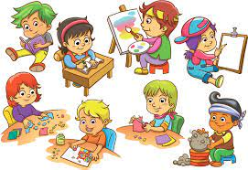
My parent or carer will use a calendar to help me see when I go back to school.
I will use the calendar to countdown, and I will tick off each day as it passes.
It is important that children return to school.
If I don’t go to school my friends, teacher and the school community will miss me.
School can help me learn new things which will support me get a job when I am older.
I would like to be ____________________________ when I’m older.
I will try to remember why going to school is important.
I will enjoy going back to school!

Slide 13
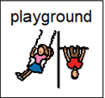
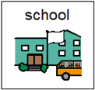
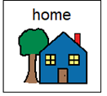
Benefits of using weekly planners / calendars:
Monday
Allows children to be recognise when school is going to start and in how many days
Helps with organisational skills
Can help ease anxiety about going back to school
Allows them to see when they will be in school and when they will be off school again
Reinforces verbal communication
How to use:
Mark the day school will start on a calendar
Encourage the child to countdown the days until school, ticking off on the calendar as each day passes
On the calendar / weekly planner put a picture of something that motivates the child under the picture of school. i.e. trip to the park, shop for sweets. This will help to encourage going to school in order to get the reward after
Have a picture of home underneath the school picture on the calendar/weekly planner to allow the child to see that school does not last forever and they will be home again once school has ended
Weekly planners are used for younger children (primary school age), calendars are usually used for older secondary school children.

Slide 14
Monday
Tuesday
Wednesday
Thursday
Friday
Saturday
Sunday

Slide 15
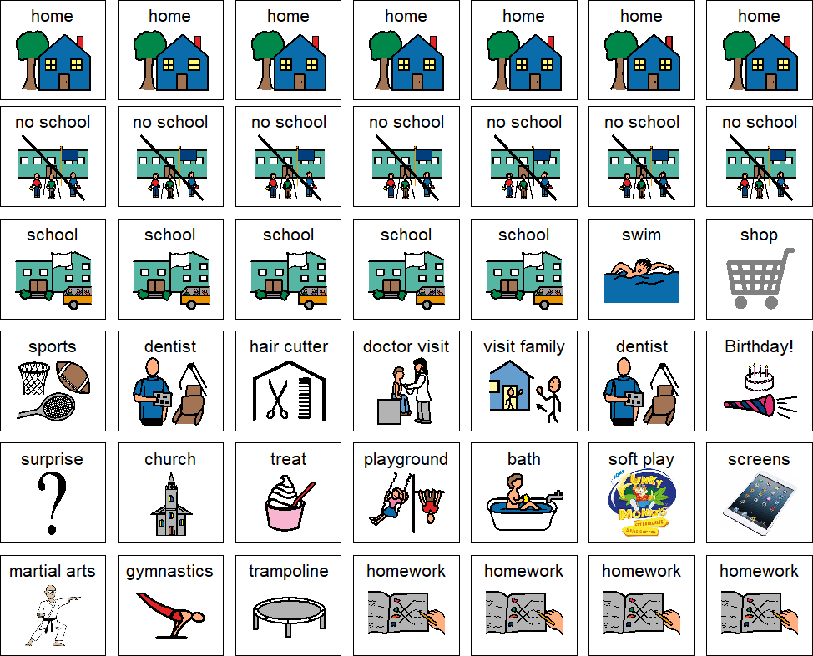
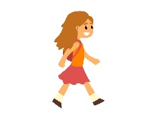
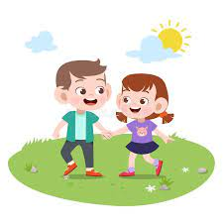
Mealtime
Quiet Time
Afterschool Club
Walk
Granny’s House
Visit friends

Slide 16
August 2024
Sunday | Monday | Tuesday | Wednesday | Thursday | Friday | Saturday
 |  |  |  | 1st | 2nd | 3rd
4th | 5th | 6th | 7th | 8th | 9th | 10th
11th | 12th | 13th | 14th | 15th | 16th | 17th
18th | 19th | 20th | 21st | 22nd | 23rd | 24th
25th | 26th | 27th | 28th | 29th | 30th | 31st

Slide 17
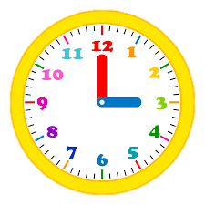
Back to school countdown
14
days
13
days
12
days
11
days
10
days
9
days
8
days
7
days
6
days
5
days
4
days
School
Today!
3
days
2
days
1
day

Slide 18
How Do I Feel?
A bit annoyed
Very angry
Sad
Ok
Happy
Angry
I feel
I feel

Slide 19
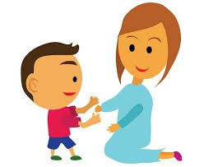
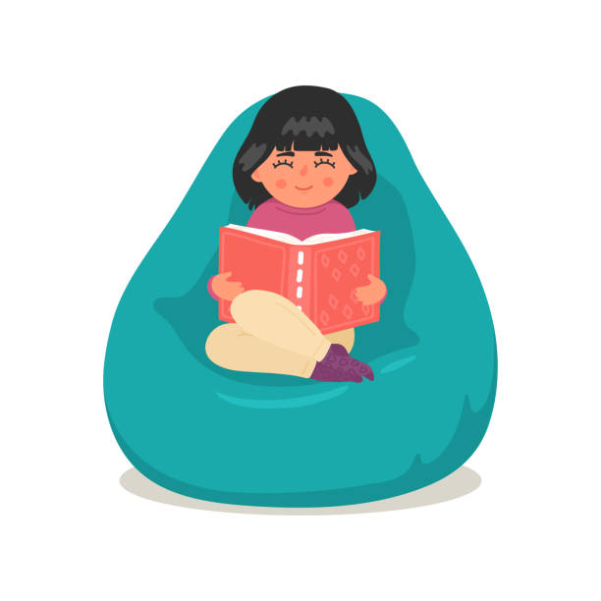
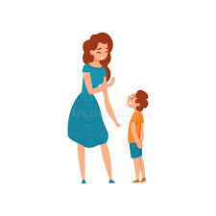
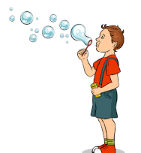
I can pick a calm choice!
Draw/colour in
Breathing
Fidgets
?
Get a hug
Punch a pillow
Quiet Time
Talk to someone
Blow bubbles
Tear Paper

Slide 20
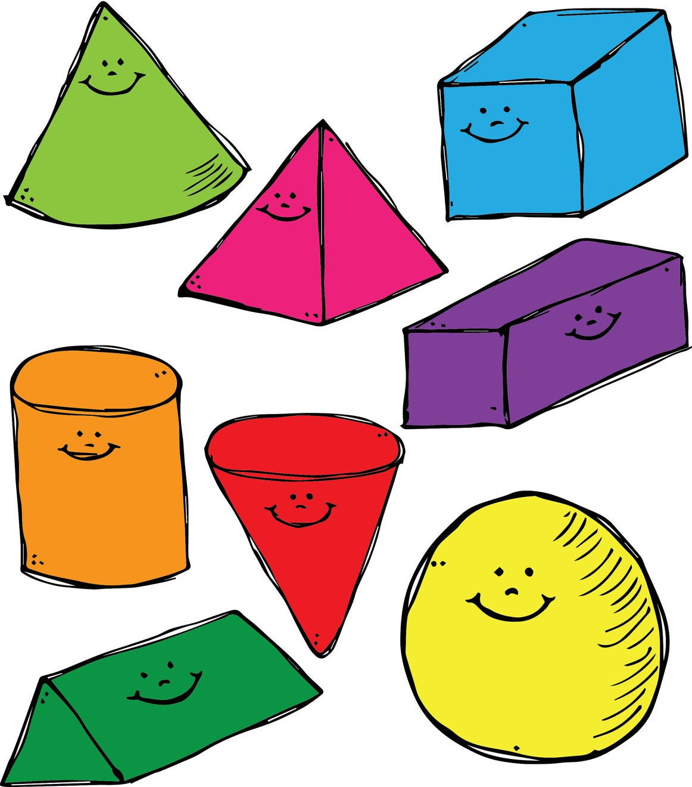
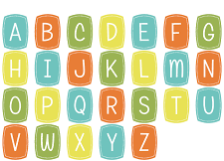
Senses 5,4,3,2,1
What can you see
5 things you can see
My
Grounding
Techniques
4 things you can hear
5 colours you
can see
4 shapes you
can see
3 soft things you
can see
3 things you can touch
2 things you can smell
2 people you
can see
1 thing you
can read
1 thing you can taste
Be A Tree
Give yourself a Power Hug
Find something in the room that begins with each letter
(until you feel calmer)
“I am firmly planted. I feel my feet rooted to the ground. My back is a strong trunk helping me feel stable in the moment. I feel my toes connecting with the ground. My arms are my branches. I feel them reach out into the world.”
Practice placing the left hand on the right shoulder for a tap and then the right hand on the left shoulder for another tap. Then squeeze into a hug and say something like “I am in control,” or “I am safe in this moment.” Tap, tap, squeeze, affirm. Tap, tap, squeeze, affirm. Repeat this as many times as needed!

