Slide 1

‘First – Then’ boards
‘First – Then’ boards, also called ‘Now – Next’ boards, can be useful in lots of ways. They are simple visuals that help with understanding what is happening, what to expect in a daily routine, and can assist with transitions to reduce anxiety.
Object level- you can use this with your children who are still at object level. Put their shoes on ‘First’ and your car keys on ‘Then’, saying ‘first shoes on, then car’.
Photo/TOBI level - you can use the ‘First – Then’ board with photos or TOBIs (True Object Based Icons). For example, first dinner, then biscuit.
Cartoon/icon level - if your child can understand photos, you can begin to introduce more abstract images, like the cartoons we have here, or icons. You can make your own, depending on what your child needs.
Written word- young people and adults can benefit from using a written first- then board. This can serve as the starting point for a schedule or a simple ‘to-do’ list. A ‘First–Then’ board can help increase motivation and support individuals who experience difficulties with working memory.

Slide 2
First
Then

Slide 3
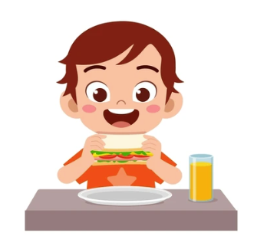
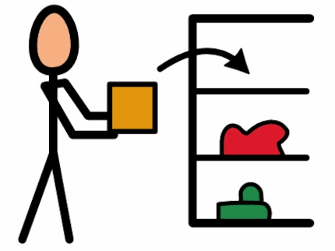
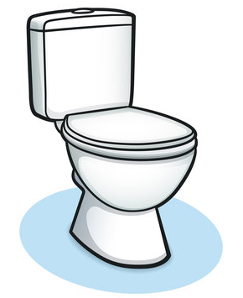
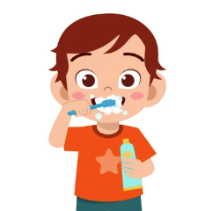
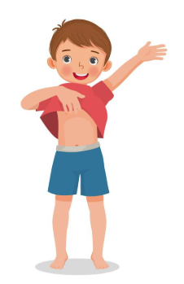
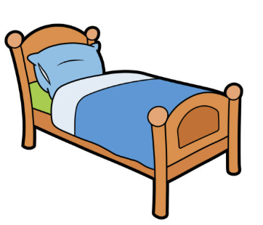


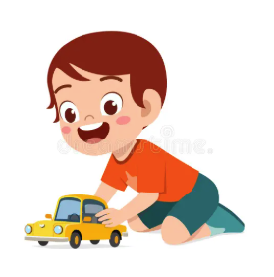
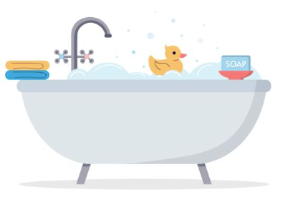

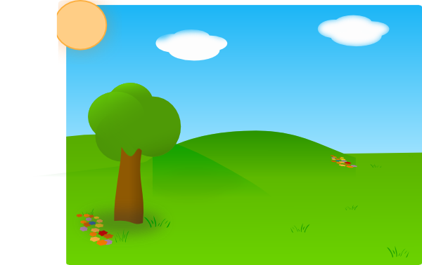
Eat
Tidy toys
Toilet
Brush teeth
Get changed
Bed
Story
TV
Play Time
Bath
Tablet
Go outside

Slide 4

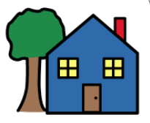
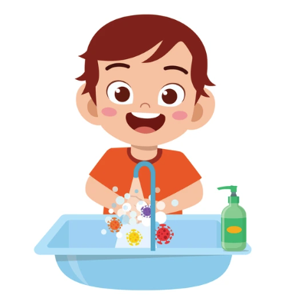
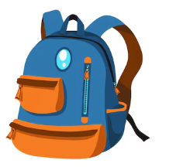
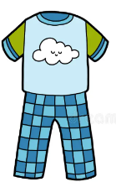
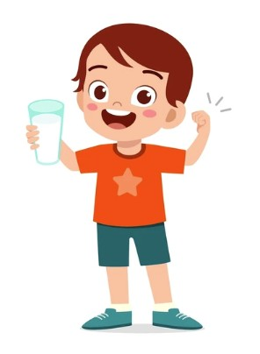
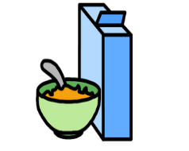
School
Home
Wash hands
Schoolbag
Pjs
Breakfast
Drink

Slide 5
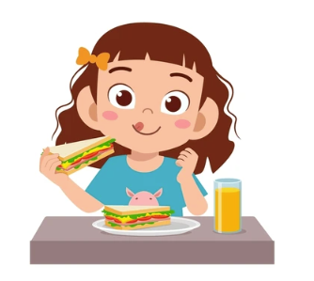
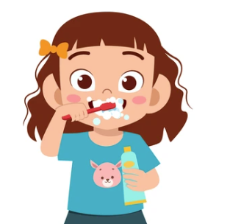
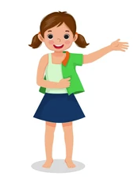
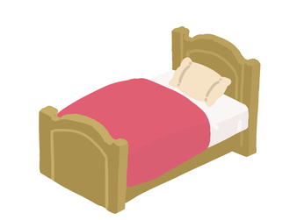
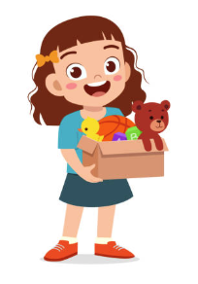
Eat
Tidy toys
Toilet
Brush teeth
Get changed
Bed
Story
TV
Play Time
Bath
Tablet
Go outside

Slide 6
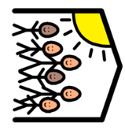
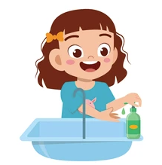
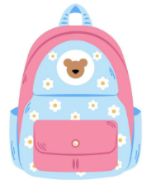
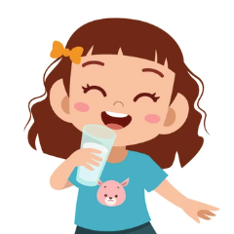
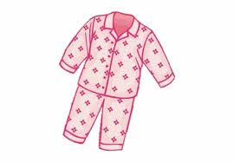
Nursery
Home
Wash hands
Schoolbag
Pjs
Breakfast
Drink

Slide 7
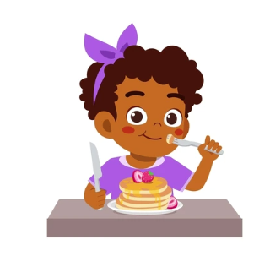
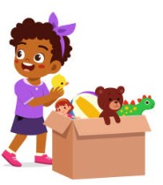
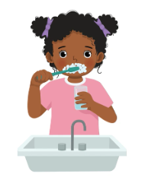
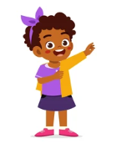
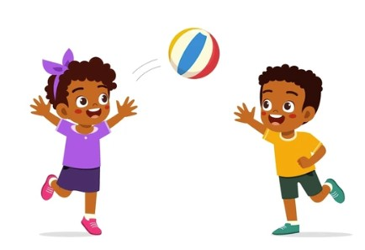
Eat
Tidy toys
Toilet
Brush teeth
Get changed
Bed
Story
TV
Play Time
Bath
Tablet
Go outside

Slide 8
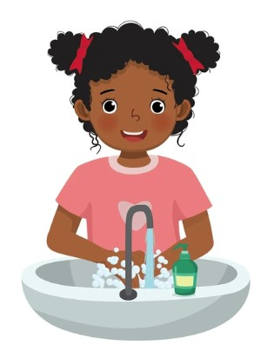
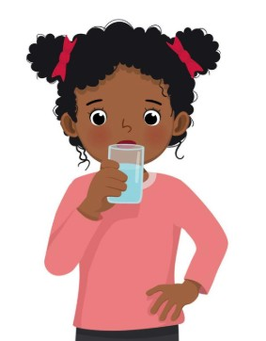
Nursery
Home
Wash hands
Schoolbag
Pjs
Breakfast
Drink

