Slide 1

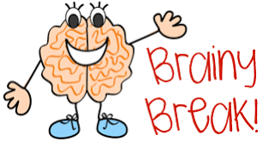
Study
Timetable
Tick

Slide 2
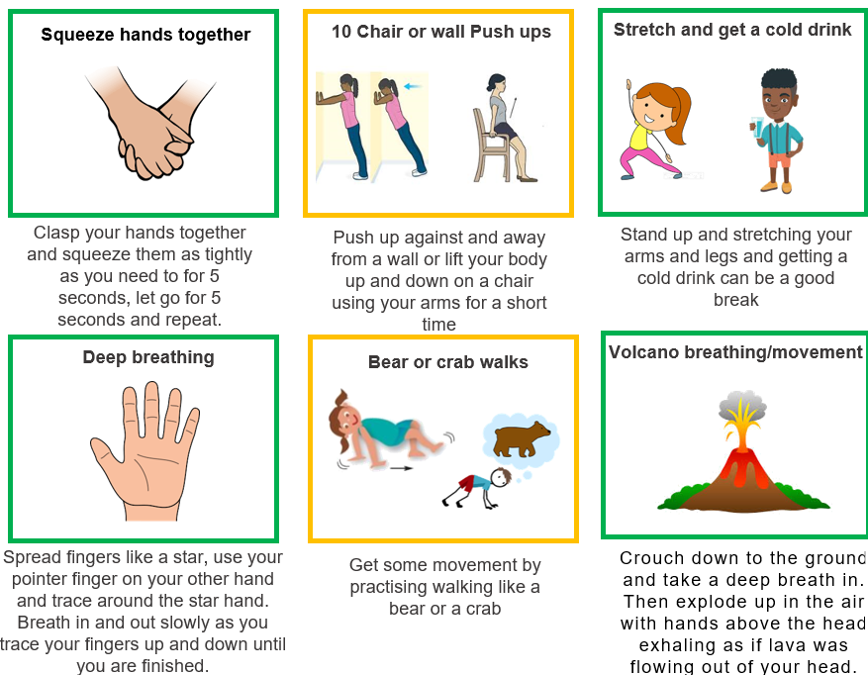
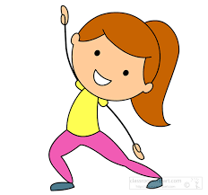
Brain Break ideas
Squeeze hands together
10 Chair or wall Push ups
Stretch and get a cold drink

Slide 3
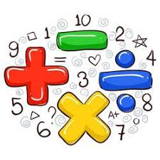







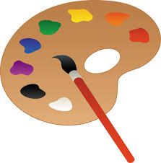
Subject Pictures
Maths
Science
Home Economics
Geography
English
History
Sports
Computer
Art

Slide 4
Subject Words
Maths
English
Science
History
Geography
Sports
Art
Computer

