Slide 1


Christmas Bingo
Cut out each bingo board and hand out to the people playing the game.
Cut out all the words and fold the words in half.
Place the words into a box or cup.
One person’s role in the game is to lift one word at a time out of the box/cup and tell the players or show what the word is.
If the word matches your picture on your board, you put an X on it.
The winner is the person who has put a X on all their pictures.
You can then swap boards and let someone else call out the words.

Slide 2

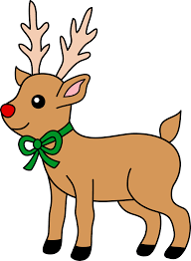
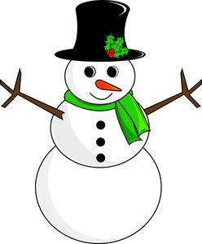



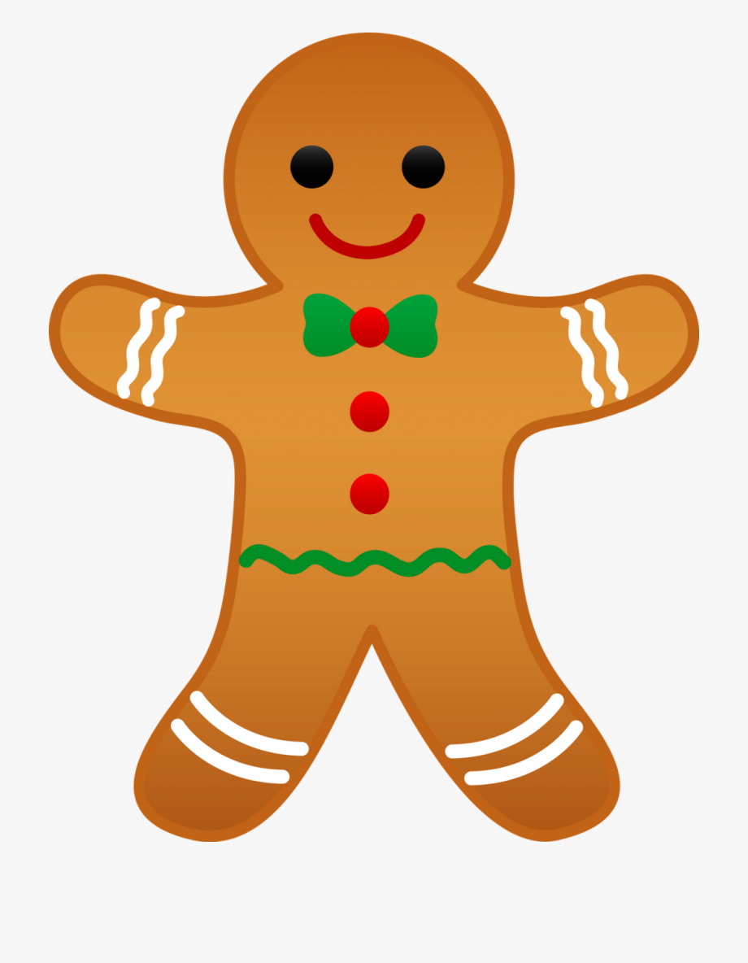



Slide 3


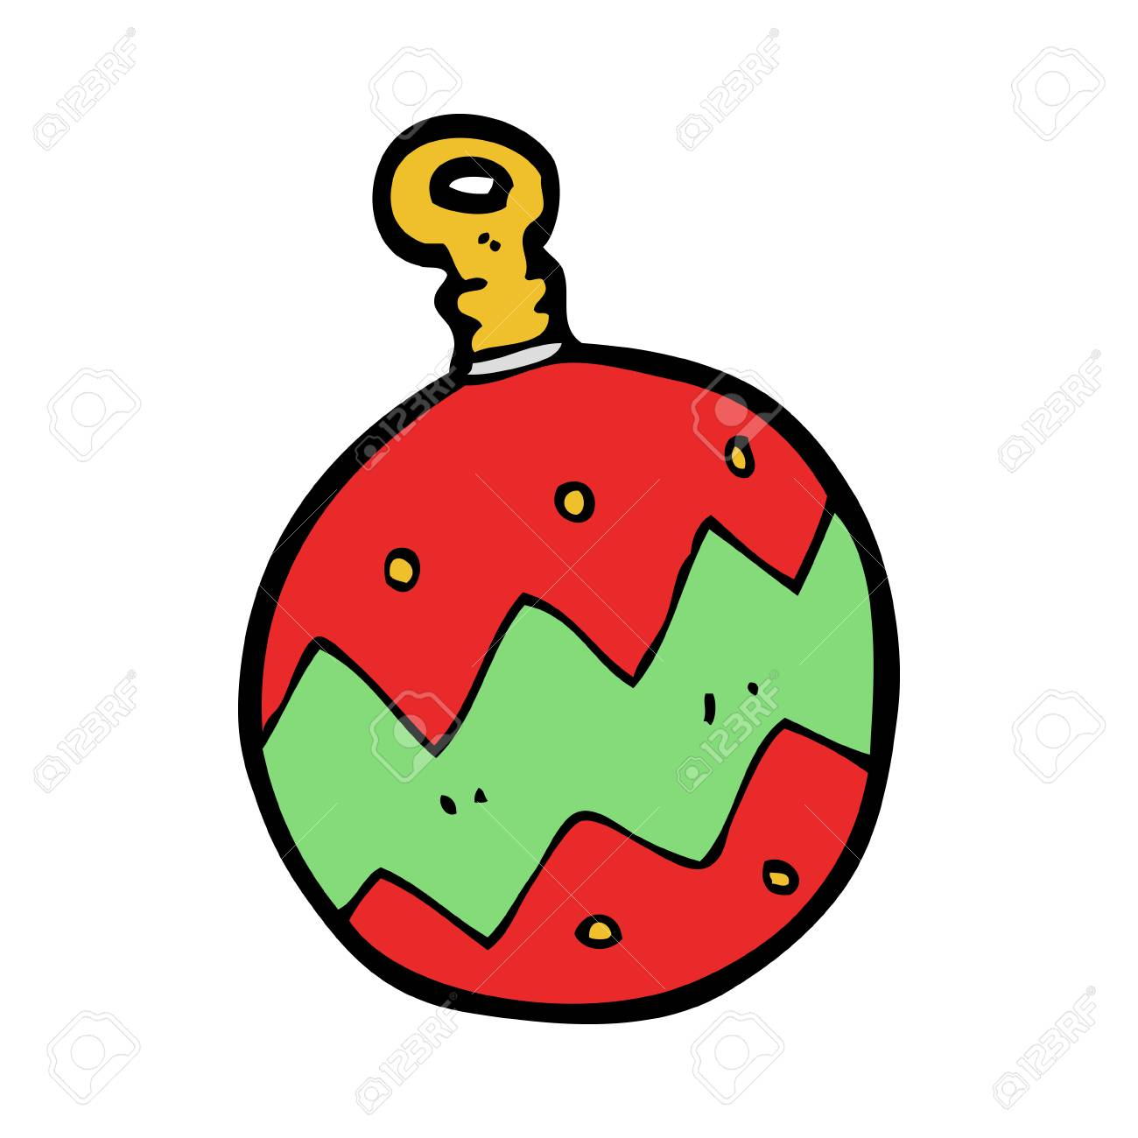

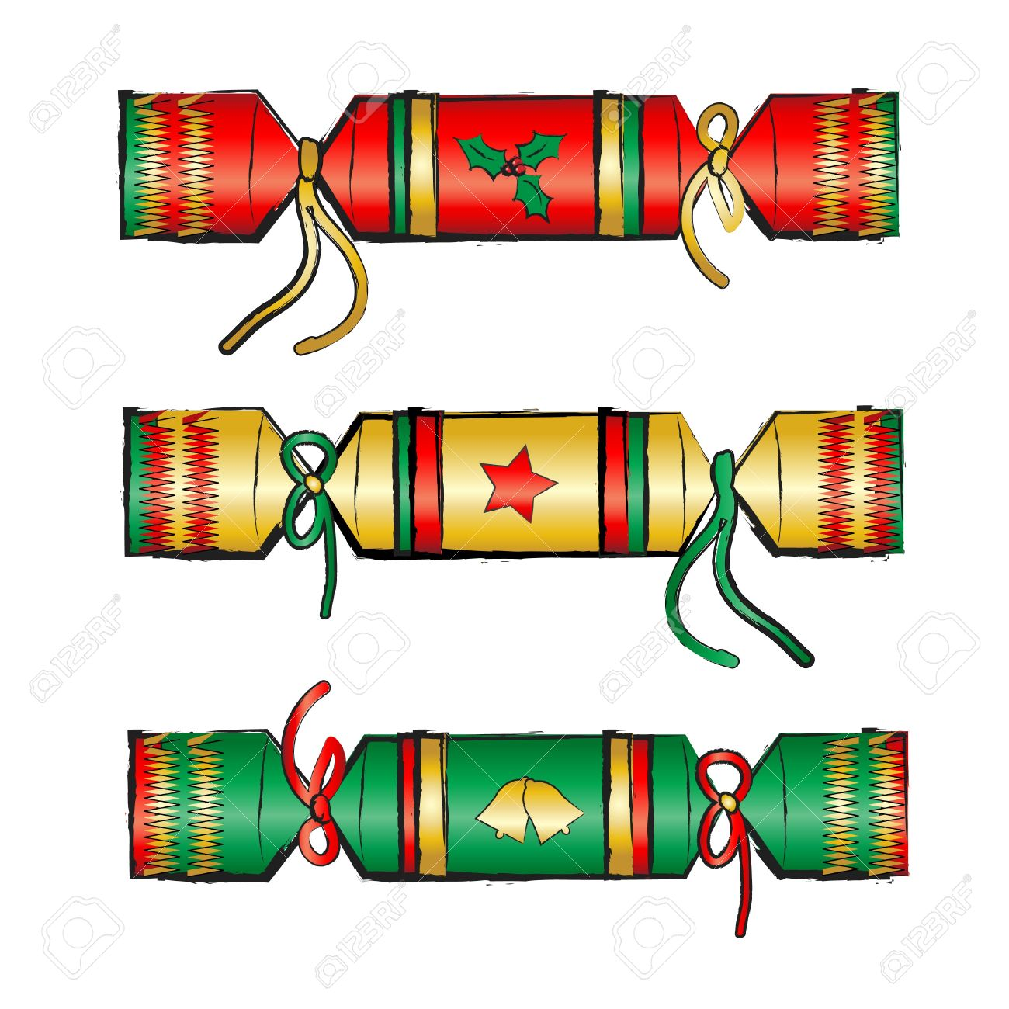

Slide 4
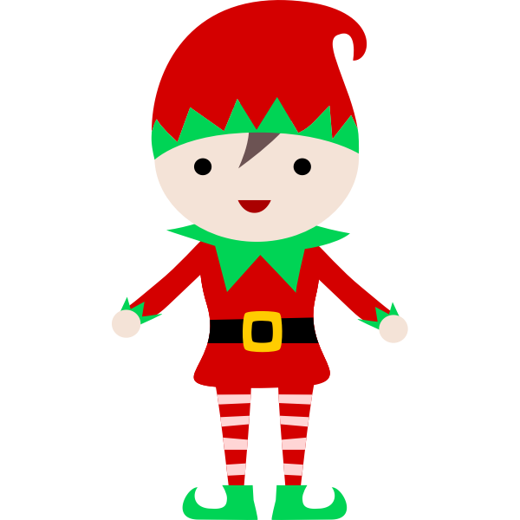
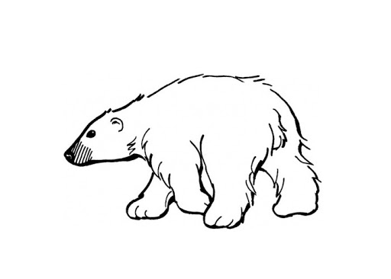


Slide 5


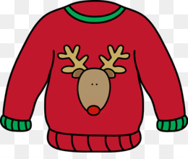

Slide 6
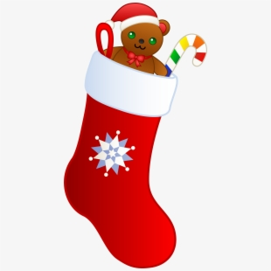



Slide 7
Snowman
Reindeer
Angel
Snowflake
Gingerbread house
Present
Sleigh
Christmas bauble
Christmas Tree
Penguin
Elf
Crackers
Star
Gingerbread man
Wreath
Candy Canes
Bells
Santa
Robin
Christmas Jumper
Holly
Stockings
Polar Bear

